Slide 1
CPS 422 Computer Networks
Week 4 & 5
Dr Faisal Bashir
CPS422: Application

Slide 2
Application Layer
Our goals:
conceptual, implementation aspects of network application protocols
  client-server paradigm
  peer-to-peer paradigm
learn about protocols by examining popular application-level protocols
  HTTP
  FTP
  Electronic Mail
  DNS
Sockets
CPS422: Application

Slide 3





Creating a network app
Write programs that
  run on different end systems and
  communicate over a network.
  e.g., Web: Web server software communicates with browser software
No software written for devices in network core
  Network core devices do not function at app layer
  This design allows for rapid app development
application
transport
network
data link
physical
application
transport
network
data link
physical
application
transport
network
data link
physical
CPS422: Application

Slide 4
Application architectures
Client-server
Peer-to-peer (P2P)
Hybrid of client-server and P2P
CPS422: Application

Slide 5
Client-server architecture
server:
  always-on host
  permanent IP address
  server farms for scaling
clients:
  communicate with server
  may have dynamic IP addresses
  do not communicate directly with each other
CPS422: Application

Slide 6
Pure P2P architecture
no always on server
arbitrary end systems directly communicate
peers are intermittently connected and change IP addresses
example: Gnutella – an open-source P2P file-sharing application
Highly scalable
each added peer increases demand as well as service capacity
Difficult to manage
CPS422: Application

Slide 7
Hybrid of client-server and P2P
Napster
  File transfer is P2P
  File search centralized:
    Peers register content at central server
    Peers query same central server to locate content
Instant messaging
  Chatting between two users is P2P
  Presence detection/location centralized:
    User registers its IP address with central server when it comes online
    User contacts central server to find IP addresses of buddies
CPS422: Application

Slide 8
App-layer protocol defines
Types of messages exchanged, eg, request & response messages
Syntax of message types: what fields in messages & how fields are represented
Semantics of the fields, ie, meaning of information in fields
Rules for when and how processes send & respond to messages
Public-domain protocols:
defined in RFCs
allows for interoperability
eg, HTTP, SMTP
Proprietary protocols:
eg, KaZaA, Skype
Applications
  (Web, E-mail)
Application Protocols
  (HTTP, SMTP)
CPS422: Application

Slide 9
What transport service does an app need?
Data loss (Reliability)
some apps (e.g., audio) can tolerate some loss
other apps (e.g., file transfer, telnet) require 100% reliable data transfer
Bandwidth
some apps (e.g., multimedia) require minimum amount of bandwidth to be “effective”
other apps (“elastic apps”) make use of whatever bandwidth they get
Timing
some apps (e.g., Internet telephony, interactive games) require low delay to be “effective”
CPS422: Application

Slide 10
Transport service requirements of common apps
Application
file transfer
e-mail
Web documents
real-time audio/video
stored audio/video
interactive games
instant messaging
Data loss
no loss
no loss
no loss
loss-tolerant
loss-tolerant
loss-tolerant
no loss
Bandwidth
elastic
elastic
elastic
audio: 5kbps-1Mbps
video:10kbps-5Mbps
same as above
few kbps up
elastic
Time Sensitive
no
no
no
yes, 100’s msec
yes, few secs
yes, 100’s msec
yes and no
CPS422: Application

Slide 11
Internet transport protocols services
TCP service:
connection-oriented: setup required between client and server processes
reliable transport between sending and receiving process
flow control: sender won’t overwhelm receiver
congestion control: throttle sender when network overloaded
does not provide: timing, minimum bandwidth guarantees
UDP service:
unreliable data transfer between sending and receiving process
does not provide: connection setup, reliability, flow control, congestion control, timing, or bandwidth guarantee
CPS422: Application

Slide 12
Internet apps: application, transport protocols
Application
layer protocol
SMTP [RFC 2821]
Telnet [RFC 854]
HTTP [RFC 2616]
FTP [RFC 959]
HTTP(e.g., Youtube)
RTP(RFC 1889)
SIP,RTP
Proprietary(e.g. Skype)
Underlying
transport protocol
TCP
TCP
TCP
TCP
TCP or UDP
typically UDP
Application
e-mail
remote terminal access
Web
file transfer
streaming multimedia
Internet telephony
CPS422: Application

Slide 13
Web and HTTP
CPS422: Application

Slide 14
Remember
Port numbers are from 0 to 65535.
Ports 0 to 1024 are “well-known ports” reserved for use by certain privileged services like http, ftp, telnet etc
Registered ports: 1024–49151
Dynamic and/or private ports: 49152–65535
Internet Assigned Numbers Authority (IANA).

Slide 15
Web and HTTP
First some jargon
Web page consists of objects
Object can be HTML file, JPEG image, Java applet, audio file,…
Web page consists of base HTML-file which includes several referenced objects
Each object is addressable by a URL
Example URL:
www.someschool.edu/someDept/pic.gif
host name
path name
CPS422: Application

Slide 16
HTTP overview
HTTP: hypertext transfer protocol
Web’s application layer protocol
client/server model
  client: browser that requests, receives, “displays” Web objects
  server: Web server sends objects in response to requests
HTTP 1.0: RFC 1945
HTTP 1.1: RFC 2068
HTTP request
PC running
Explorer
HTTP response
HTTP request
Server
running
Apache Web
server
HTTP response
Mac running
Navigator
CPS422: Application

Slide 17
HTTP overview (continued)
Uses TCP:
client initiates TCP connection (creates socket) to server, port 80
server accepts TCP connection from client
HTTP messages (application-layer protocol messages) exchanged between browser (HTTP client) and Web server (HTTP server)
TCP connection closed
HTTP is “stateless”
server maintains no information about past client requests
aside
Protocols that maintain “state” are complex!
past history (state) must be maintained
if server/client crashes, their views of “state” may be inconsistent, must be reconciled
CPS422: Application

Slide 18
HTTP Example
(contains text,
references to 10
jpeg images)
Suppose user enters URL www.mcs.edu.pk/CSDept/home.index
1a. HTTP client initiates TCP connection to HTTP server (process) at www.mcs.edu.pk on port 80
1b. HTTP server at host www.mcs.edu.pk waiting for TCP connection at port 80. “accepts” connection, notifying client
2. HTTP client sends HTTP request message (containing URL) into TCP connection socket. Message indicates that client wants object CSDept/home.index
3. HTTP server receives request message, forms response message containing requested object, and sends message into its socket
time
CPS422: Application

Slide 19
HTTP (cont.)
4. HTTP server closes TCP connection.
5. HTTP client receives response message containing html file, displays html. Parsing html file, finds 10 referenced jpeg objects
time
6. Steps 1-5 repeated for each of 10 jpeg objects
CPS422: Application

Slide 20
Response time modeling
Definition of RTT: time for a small packet to travel from client to server and back.
Response time:
one RTT to initiate TCP connection
one RTT for HTTP request and first few bytes of HTTP response to return
file transmission time
total = 2RTT+transmit time
initiate TCP
connection
RTT
request
file
RTT
time to
transmit
file
file
received
time
time
CPS422: Application

Slide 21
Persistent Vs Non-Persistent
non-persistent connection: one object in each TCP connection
  some browsers create multiple TCP connections simultaneously - one per object (HTTP v1.0)
persistent connection: multiple objects transferred within one TCP connection (HTTP v.1.1)

Slide 22
Persistent Vs Non-Persistent
Nonpersistent HTTP issues:
requires 2 RTTs per object
OS must work and allocate host resources for each TCP connection
but browsers often open parallel TCP connections to fetch referenced objects
Persistent HTTP
server leaves connection open after sending response
subsequent HTTP messages between same client/server are sent over connection
Persistent without pipelining:
client issues new request only when previous response has been received
one RTT for each referenced object
Persistent with pipelining:
default in HTTP/1.1
client sends requests as soon as it encounters a referenced object
as little as one RTT for all the referenced objects
CPS422: Application

Slide 23

HTTP request message: general format
CPS422: Application

Slide 24
HTTP request message
two types of HTTP messages: request, response
HTTP request message:
  ASCII (human-readable format)
request line
(GET, POST,
HEAD commands)
GET /somedir/page.html HTTP/1.1
Host: www.someschool.edu
User-agent: Mozilla/4.0
Connection: close
Accept-language: en-us
(extra carriage return, line feed)
header
lines
Carriage return,
line feed
indicates end
of message
CPS422: Application

Slide 25
HTTP response message
status line
(protocol
status code
status phrase)
HTTP/1.1 200 OK
Connection close
Date: Thu, 06 Aug 1998 12:00:15 GMT
Server: Apache/1.3.0 (Unix)
Last-Modified: Mon, 22 Jun 1998 …...
Content-Length: 6821
Content-Type: text/html
data data data data data ...
header
lines
data, e.g.,
requested
HTML file
CPS422: Application

Slide 26
Method types
HTTP/1.0
GET
POST
  Input (eg, forms) is uploaded to server in entity body
HEAD
  asks server to leave requested object out of response
HTTP/1.1
GET, POST, HEAD
PUT
  uploads file in entity body to path specified in URL field
DELETE
  deletes file specified in the URL field
Application Layer
2: Application Layer

Slide 27
HTTP response status codes
In first line in server->client response message.
A few sample codes:
200 OK
  request succeeded, requested object later in this message
301 Moved Permanently
  requested object moved, new location specified later in this message (Location:)
400 Bad Request
  request message not understood by server
404 Not Found
  requested document not found on this server
505 HTTP Version Not Supported
CPS422: Application

Slide 28
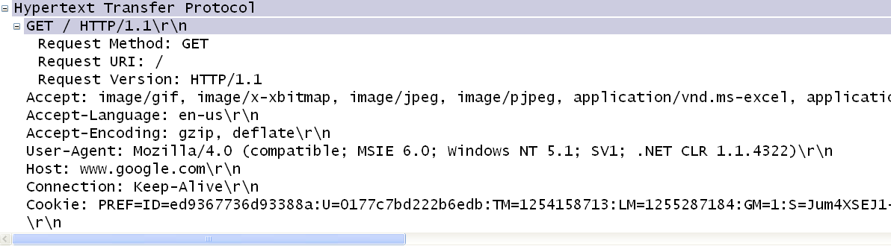
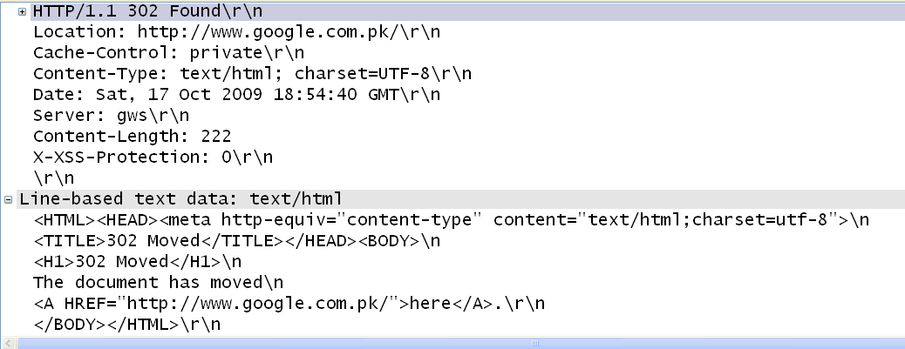
Wireshark Output
HTTP Request
HTTP Response
CPS422: Application

Slide 29
Trying out HTTP (client side) for yourself
1. Telnet to your favorite Web server:
telnet www.google.com 80
Opens TCP connection to port 80
(default http server port) at www.google.com
Anything typed in sent
to port 80 at www.google.com
2. Type in a GET http request:
GET / HTTP/1.1
By typing this in (hit carriage
return twice), you send
this minimal (but complete)
GET request to http server
3. Look at response message sent by the http server.
CPS422: Application

Slide 30
Task1
What are the various method types in HTTP1.0 and HTTP1.1, and what are they used for?
CPS422: Application

Slide 31
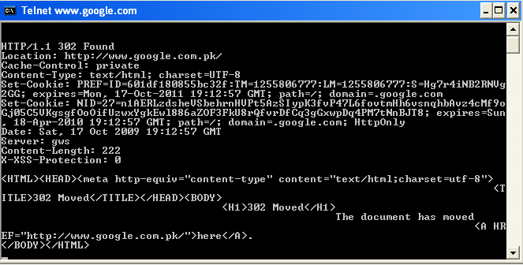
CPS422: Application

Slide 32
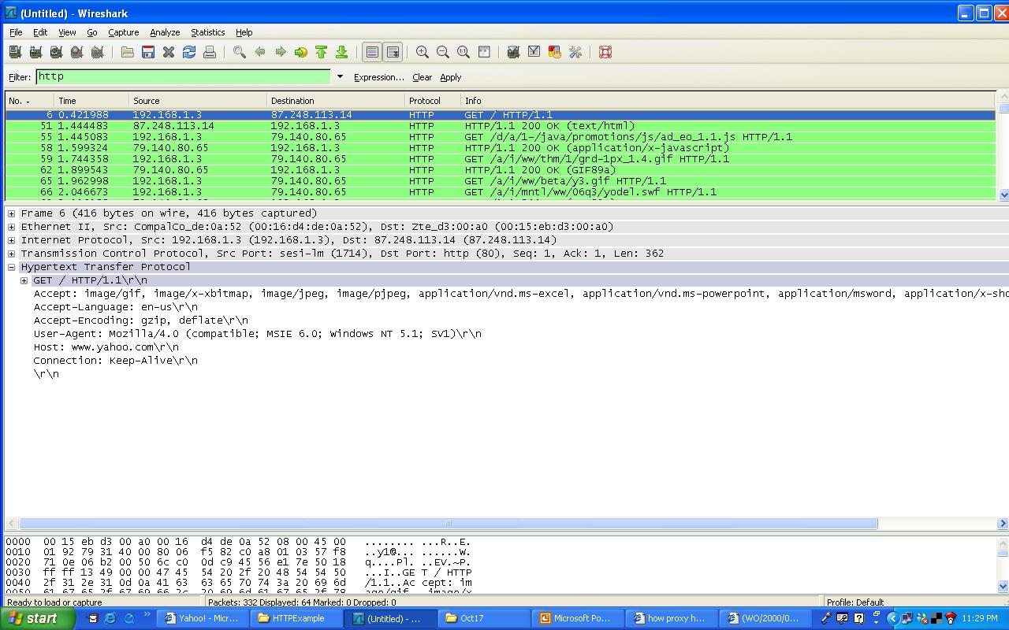
HTTP Request
CPS422: Application

Slide 33
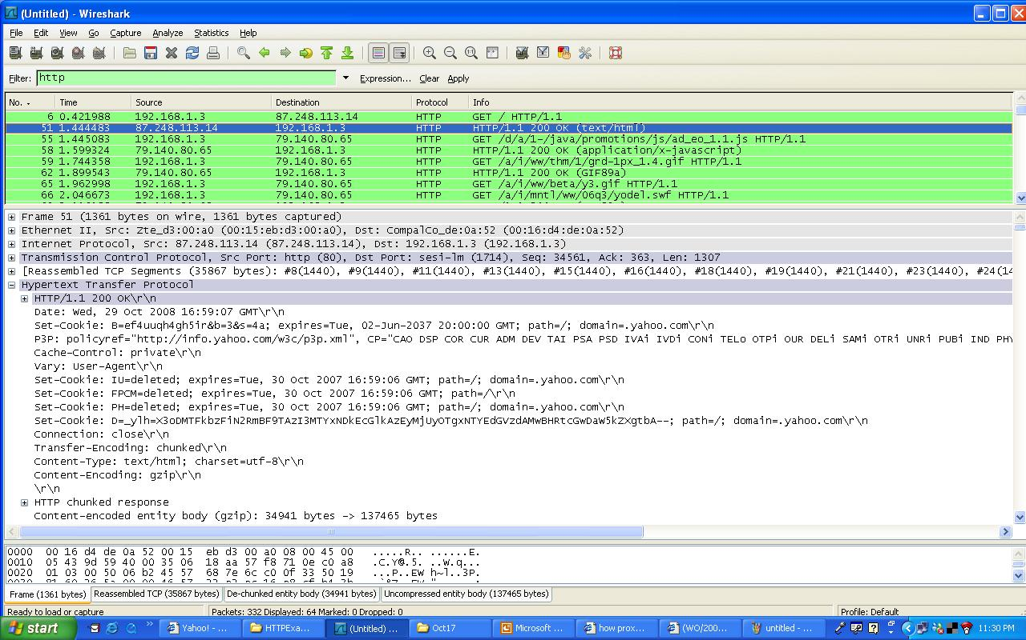
HTTP Response
CPS422: Application

Slide 34
Web caches (proxy server)
Goal: satisfy client request without involving origin server
user sets browser: Web accesses via cache
browser sends all HTTP requests to cache
  object in cache: cache returns object
  else cache requests object from origin server, then returns object to client
origin
server
Proxy
server
HTTP request
HTTP request
client
HTTP response
HTTP response
HTTP request
HTTP response
client
origin
server
CPS422: Application

Slide 35
More about Web caching
Cache acts as both client and server
Typically cache is installed by ISP (university, company, residential ISP)
Why Web caching?
Reduce response time for client request.
Reduce traffic on an institution’s access link.
Substantially reduce web traffic in the internet as a whole
CPS422: Application

Slide 36
User-server interaction: conditional GET
client
server
Goal: don’t send object if client has up-to-date stored (cached) version
client: specify date of cached copy in http request
  If-modified-since: <date>
server: response contains no object if cached copy up-to-date:
  HTTP/1.0 304 Not Modified
http request msg
If-modified-since: <date>
object
not
modified
http response
HTTP/1.0
304 Not Modified
http request msg
If-modified-since: <date>
object
modified
http response
HTTP/1.1 200 OK
…
<data>
CPS422: Application

Slide 37
User-server interaction: Authentication
Goal: control access to server documents
stateless: client must present authorization in each request
authorization: typically name, password
  authorization: header line in request
  if no authorization presented, server refuses access, sends
    WWW authenticate:
    header line in response
server
client
usual http request msg
401: authorization req.
WWW authenticate:
usual http request msg
+ Authorization:line
usual http response msg
usual http request msg
+ Authorization:line
usual http response msg
time
Application Layer

Slide 38
User-server interaction: Cookies
Cookies is a way of remembering things for you (e.g., authentication, user preferences, previous choices)
server sends “cookie” to client in response
  Set-cookie: #
client present cookie in later requests
  cookie: #
server matches presented-cookie with server-stored cookies
http://cookiescache.tripod.com/
client
server
usual http request msg
usual http response +
Set-cookie: #
usual http request msg
cookie: #
cookie-
specific
action
usual http response msg
usual http request msg
cookie: #
cookie-
specific
action
usual http response msg
Application Layer

Slide 39
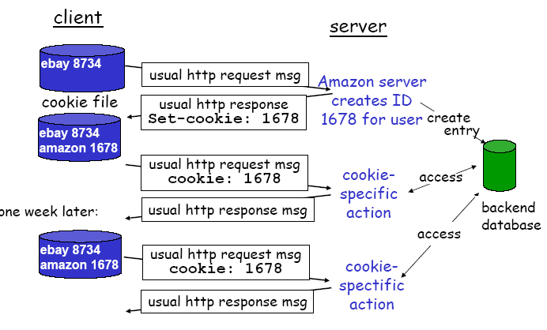
Cookies: keeping “state”
CPS422: Application

Slide 40
FTP

Slide 41

FTP: the file transfer protocol
FTP
user
interface
FTP
client
file transfer
FTP
server
user
at host
local file
system
remote file
system
transfer file to/from remote host
client/server model
  client: side that initiates transfer (either to/from remote)
  server: remote host
ftp: RFC 959
ftp server: port 21
Application Layer

Slide 42
FTP: separate control, data connections
ftp client contacts ftp server at port 21, specifying TCP as transport protocol
two parallel TCP connections opened:
  control: exchange commands, responses between client, server.
    “out of band control”
  data: file data to/from server
ftp server maintains “state”: current directory, earlier authentication
TCP control connection
port 21
FTP
client
TCP data connection
port 20
FTP
server
Application Layer

Slide 43
Passive Mode FTP
client
FTP Server
client
FTP Server
2834
connect
21
2834
connect
21
accept
accept
active mode 2835
passive mode request
passive mode 3848
connect
20
connect
3848
2835
data transfer
2835
data transfer
2835
20
2835
3848
2834
disconnect
21
2834
disconnect
21
accept
accept
Active Mode
Passive Mode
Passive Mode FTP
  when client is located inside a firewall.
  Use dynamically generated port number instead of 20
  A client connect to the FTP server first for data transfer
  Cannot detect the ftp data transfer by the packet header only
Application Layer

Slide 44
Electronic Mail

Slide 45
Electronic Mail
outgoing
message queue
Three major components:
user agents
mail servers
simple mail transfer protocol (SMTP) is used between mail servers
User Agent
“mail reader”
composing, editing, reading mail messages
e.g., Outlook, elm, mutt
also uses SMTP between agent and server
user mailbox
user
agent
mail
server
user
agent
SMTP
mail
server
user
agent
SMTP
SMTP
mail
server
user
agent
user
agent
user
agent
Application Layer

Slide 46
Electronic Mail: mail servers
Mail Servers
mailbox contains incoming messages (yet to be read) for users
message queue of outgoing (to be sent) mail messages
smtp protocol between mail servers to send email messages
  client: sending mail server
  “server”: receiving mail server
user
agent
mail
server
user
agent
SMTP
mail
server
user
agent
SMTP
SMTP
mail
server
user
agent
user
agent
user
agent
Application Layer

Slide 47
Electronic Mail: SMTP [RFC 821]
uses TCP to reliably transfer email msg from client to server, port 25
direct transfer: sending server to receiving server
three phases of transfer
  handshaking (greeting)
  transfer
  closure
command/response interaction
  commands: ASCII text
  response: status code and phrase
Application Layer

Slide 48
Mail message format
RFC 822: standard for text message format:
header lines
  To:
  From:
  Subject:
body
  the “message”, ASCII characters only
line containing only `.’
header
blank
line
body
.
Application Layer

Slide 49
Message format: multimedia extensions
MIME: Multipurpose Internet Mail Extension, RFC 2045, 2056
MIME content type declared in msg header
MIME version
From: alice@crepes.fr
To: bob@hamburger.edu
Subject: Picture of network.
MIME-Version: 1.0
Content-Transfer-Encoding: base64
Content-Type: image/jpeg
base64 encoded data .....
.........................
......base64 encoded data
.
method used
to encode data
multimedia data
type, subtype,
parameter declaration
encoded data
Application Layer

Slide 50
MIME types
Text
example subtypes: plain, html
Image
example subtypes: jpeg, gif
Audio
example subtypes: basic (8-bit mu-law encoded), 32kadpcm (32 kbps coding)
Video
example subtypes: mpeg, quicktime
Application
other data that must be processed by reader before “viewable”
example subtypes: msword, octet-stream
Application Layer

Slide 51

Mail access protocols
SMTP
SMTP
POP3 or
IMAP
user
agent
user
agent
sender’s mail
server
receiver’s mail
server
SMTP: delivery/storage to receiver’s server
Mail Access Protocol: retrieval from server
  POP: Post Office Protocol [RFC 1939]
    authorization (agent <-->server) and download
  IMAP: Internet Mail Access Protocol [RFC 1730]
    more features (more complex)
    manipulation of stored msgs on server
Application Layer

Slide 52
POP3 protocol
S: +OK POP3 server ready
C: user alice
S: +OK
C: pass hungry
S: +OK user successfully logged on
authorization phase
client commands:
  user: username
  pass: password
server responses
  +OK
  -ERR
C: list
S: 1 498
S: 2 912
S: .
C: retr 1
S: <message 1 contents>
S: .
C: dele 1
C: retr 2
S: <message 1 contents>
S: .
C: dele 2
C: quit
S: +OK POP3 server signing off
transaction phase, client:
list: list message numbers
retr: retrieve message by number
dele: delete
quit
Application Layer

Slide 53
IMAP
More functionalities than POP
  users can manipulate messages on server, e.g., to create hierarchy of folders
  folders organization accessed from all user’s machines (office, @home, mobile)
  users can retrieve only part(s) of a multipart message, e.g., downloading in a small portable terminal only header or text part of a multimedia message.
More complex
  server maintains state, e.g., hierarchy of folders for each user
Application Layer

Slide 54
Web Mail
HTTP
SMTP
HTTP
user
agent
ordinary
Web browser
user
agent
ordinary
Web browser
sender’s mail
server
receiver’s mail
server
Convenient for the user on the go (Internet Café, WebTV, …)
User can organize their hierarchy of folders on servers
May be slow:
  server typically far from client
  interaction with server through scripts
Application Layer

